Slide 1
The 8051 Microcontroller and Embedded Systems
CHAPTER 11
INTERRUPTS PROGRAMMING IN ASSEMBLY
vignan university

Slide 2
OBJECTIVES
Contrast and compare interrupts versus polling
Explain the purpose of the ISR (interrupt service routine)
List the 6 interrupts of the 8051
Explain the purpose of the interrupt vector table
Enable or disable 8051 interrupts
Program the 8051 timers using interrupts
Describe the external hardware interrupts of the 8051
Contrast edge-triggered with level-triggered interrupts
Program the 8051 for interrupt-based serial communication
Define the interrupt priority of the 8051
vignan university

Slide 3
SECTION 11.1: 8051 INTERRUPTS
Interrupts vs. polling
  on receiving interrupt, the microcontroller interrupts whatever it is doing and executes interrupt service routine (ISR)
  microcontroller can serve many devices
  each device gets attention based on the priority
  polling wastes time
vignan university

Slide 4
SECTION 11.1: 8051 INTERRUPTS
Interrupt service routine
  for each interrupt there must be ISR
  for every interrupt, there is a fixed location in memory that holds the address of its ISR
  interrupt vector table
vignan university

Slide 5
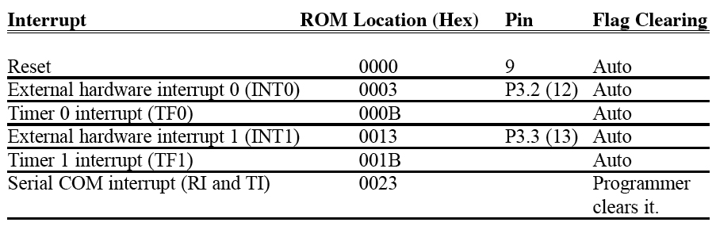
SECTION 11.1: 8051 INTERRUPTS
Table 11–1 Interrupt Vector Table for the 8051
vignan university

Slide 6
SECTION 11.1: 8051 INTERRUPTS
Steps in executing an interrupt
  μC finishes the instruction it is executing and saves the address of the next instruction (PC) on the stack
  it saves the current status of all the interrupts internally
  it jumps to a fixed location in memory called the interrupt vector table
  the microcontroller gets the address of the ISR from the interrupt vector table and jumps to it and starts to execute the ISR until it reaches the last instruction RETI
  the microcontroller returns to the place where it was interrupted, it gets the PC address from the stack by popping the top two bytes of the stack into the PC and then it starts to execute from that address
vignan university

Slide 7
SECTION 11.1: 8051 INTERRUPTS
Six interrupts in the 8051
  1 reset interrupt, when the reset pin is activated, the 8051 jumps to address location 0000
  2 timer interrupts
  2 external hardware interrupts
  pin 12 (P3.2) and 13 (P3.3) in port 3 are for the external hardware interrupts
  1 serial communication interrupt that belongs to both receive and transmit
  a limited number of bytes is set aside for each interrupt
vignan university

Slide 8
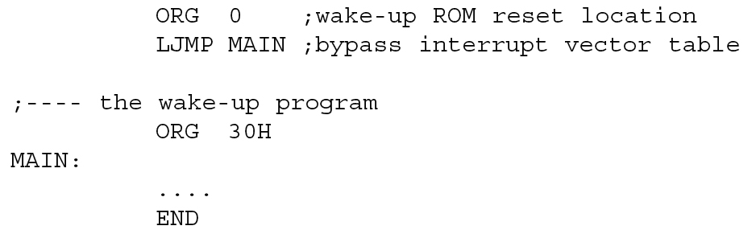
SECTION 11.1: 8051 INTERRUPTS
Figure 11–1 Redirecting the 8051 from the Interrupt Vector Table at Power-up
vignan university

Slide 9
SECTION 11.1: 8051 INTERRUPTS
Enabling and disabling an interrupt
  upon reset all interrupts are disabled
  interrupts must be enabled by software
  IE register (interrupt enable) is responsible for enabling and disabling the interrupts
  IE is a bit-addressable register
vignan university

Slide 10
SECTION 11.1: 8051 INTERRUPTS
Steps in enabling an interrupt
  EA must be set to 1
  set the relevant bits in IE register to high
  EA = 0, no interrupt will be responded to, even if the relevant bit in the IE register is high
vignan university

Slide 11
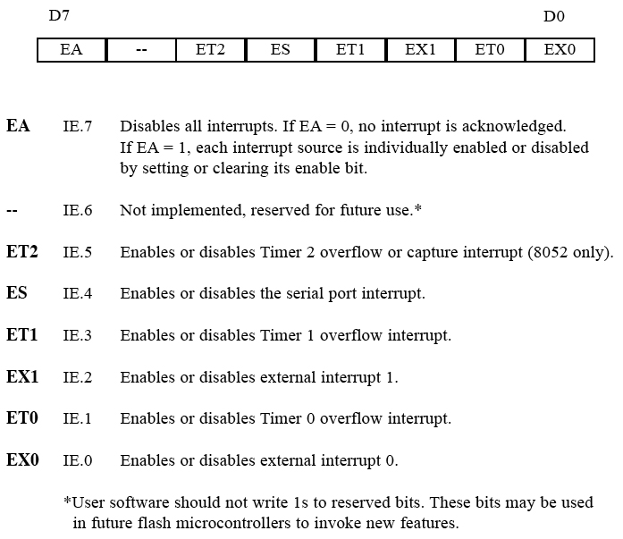
SECTION 11.1: 8051 INTERRUPTS
Figure 11–2 IE (Interrupt Enable) Register
vignan university

Slide 12
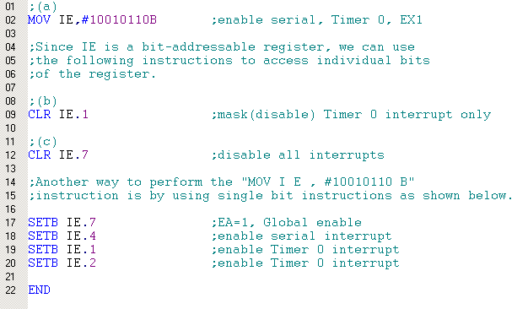
Example 11-1
Show the instructions to (a) enable the serial interrupt, Timer 0 interrupt, and external hardware interrupt 1 (EX1), and (b) disable (mask) the Timer 0 interrupt, then (c) show how to disable all the interrupts with a single instruction.
vignan university

Slide 13
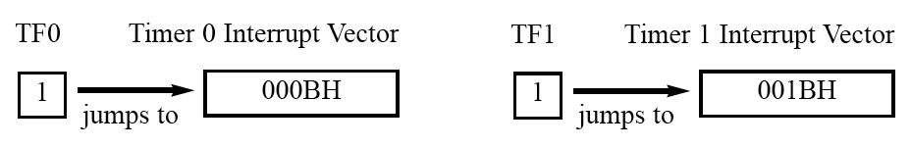
SECTION 11.2: PROGRAMMING TIMER INTERRUPTS
Roll-over timer flag and interrupt
  if the timer interrupt is enabled, whenever TF=1, the microcontroller is interrupted in whatever it is doing, and jumps to the interrupt vector table to service the ISR
  In this way, the microcontroller can do other things until it is notified that the timer has rolled over
Figure 11–3 TF Interrupt
vignan university

Slide 14
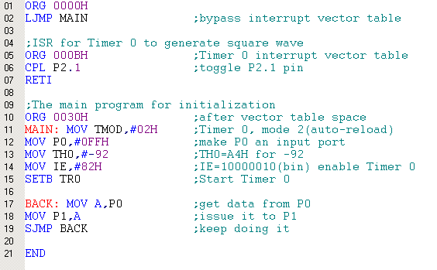
Example 11-2
Write a program that continuously gets 8-bit data from P0 and sends it to P1 while simultaneously creating a square wave of 200 μs period on pin P2.1. Use Timer 0 to create the square wave. Assume that XTAL = 11.0592 MHz.
vignan university

Slide 15
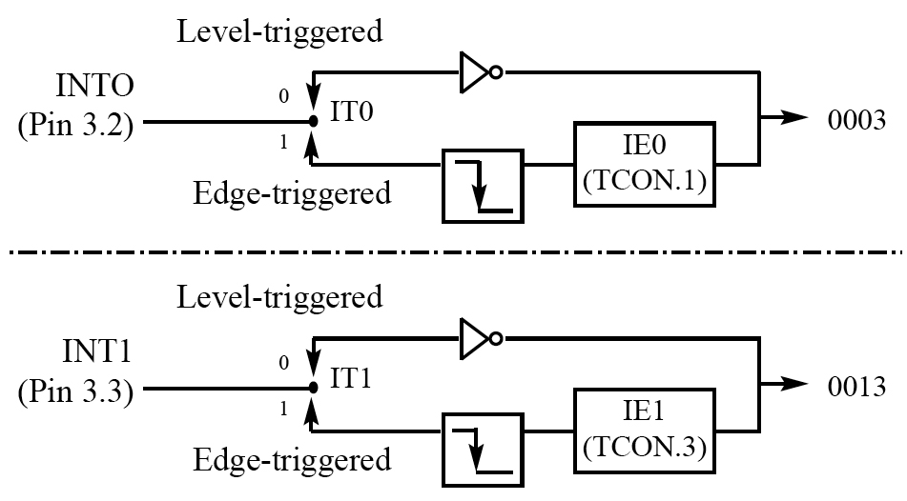
SECTION 11.3: PROGRAMMING EXTERNAL HARDWARE INTERRUPTS
External interrupts INT0 and INT1
Figure 11–4 Activation of INT0 and INT1
vignan university

Slide 16
SECTION 11.3: PROGRAMMING EXTERNAL HARDWARE INTERRUPTS
Level-triggered interrupt
  INT0 and INT1 pins are normally high
  if low-level signal is applied, it triggers the interrupt
  microcontroller stops whatever it is doing and jumps to the interrupt vector table to service the interrupt
  the low­level signal must be removed before the execution of the last instruction of the interrupt service routine, RETI
  otherwise, another interrupt will be generated
vignan university

Slide 17
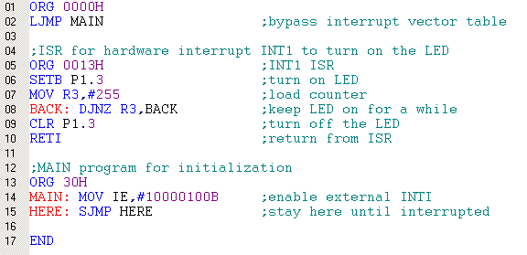
Example 11-5
Assume that the INT1 pin is connected to a switch that is normally high. Whenever it goes low, it should turn on an LED. The LED is connected to P1.3 and is normally off. When it is turned on it should stay on for a fraction of a second. As long as the switch is pressed low, the LED should stay on.
vignan university

Slide 18
SECTION 11.3: PROGRAMMING EXTERNAL HARDWARE INTERRUPTS
Sampling the low level-triggered interrupt
  to ensure the activation of the hardware interrupt at the INTx pin, make sure that the duration of the low-level signal is around 4 machine cycles
vignan university

Slide 19
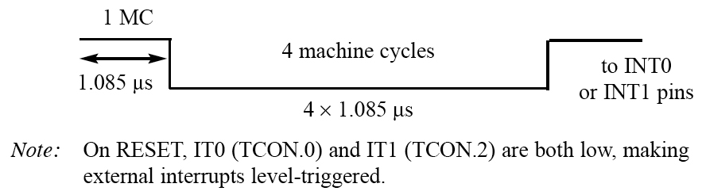
SECTION 11.3: PROGRAMMING EXTERNAL HARDWARE INTERRUPTS
Sampling the low level-triggered interrupt
Figure 11–5 Minimum Duration of the Low Level-Triggered
Interrupt (XTAL = 11.0592 MHz)
vignan university

Slide 20
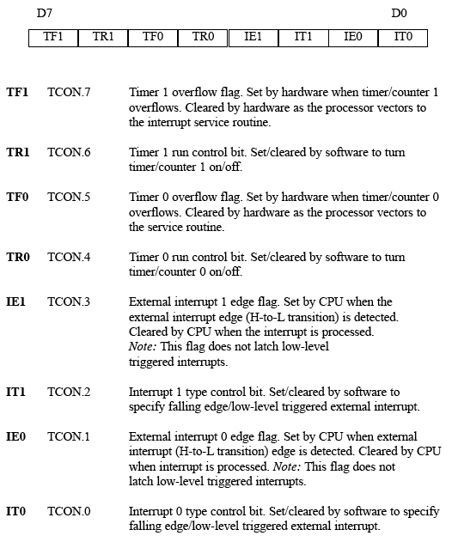
SECTION 11.3: PROGRAMMING EXTERNAL HARDWARE INTERRUPTS
Edge-triggered interrupts
Figure 11–6
TCON (Timer/Counter)
Register (Bit-addressable)
vignan university

Slide 21
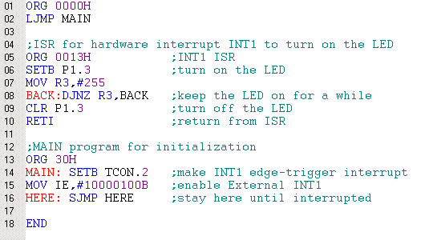
Example 11-6
Assuming that INT1 is connected to a pulse generator. Write a program in which the falling edge of the pulse will send a high to P 1.3, which is connected to an LED.
vignan university

Slide 22
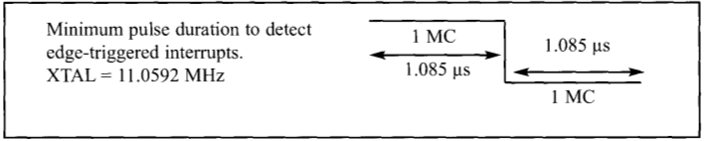
SECTION 11.3: PROGRAMMING EXTERNAL HARDWARE INTERRUPTS
Sampling the edge-triggered interrupt
  external source must be held high for at least one machine cycle, and then held low for at least one machine cycle to ensure that the transition is seen by the microcontroller
vignan university

Slide 23
SECTION 11.3: PROGRAMMING EXTERNAL HARDWARE INTERRUPTS
More about the TCON register
Figure 11–6
TCON (Timer/Counter) Register
(Bit-addressable)
vignan university

Slide 24
SECTION 11.4: PROGRAMMING THE SERIAL COMMUNICATION INTERRUPT
RI and TI flags and interrupts
  1 interrupt is set for serial communication
  used to both send and receive data
  when RI or TI is raised the 8051 gets interrupted and jumps to memory address location 0023H to execute the ISR
  the ISR must examine the TI and RI flags to see which one caused the interrupt and respond accordingly
vignan university

Slide 25
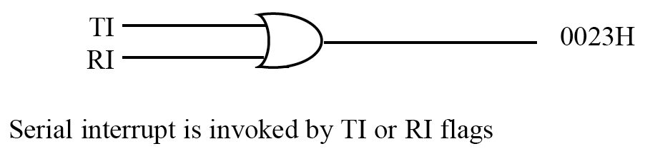
SECTION 11.4: PROGRAMMING THE SERIAL COMMUNICATION INTERRUPT
Figure 11–7 Single Interrupt for Both TI and RI
vignan university

Slide 26
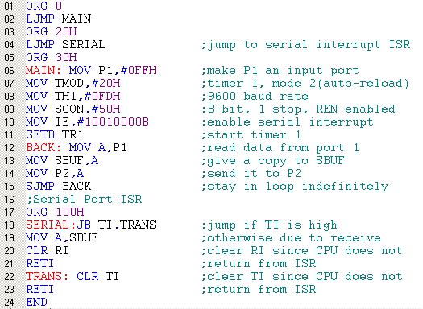
Example 11-8
Write a program in which the 8051 reads data from P1 and writes it to P2 continuously while giving a copy of it to the serial COM port to be transferred serially. Assume that XTAL = 11.0592 MHz. Set the baud rate at 9600.
vignan university

Slide 27
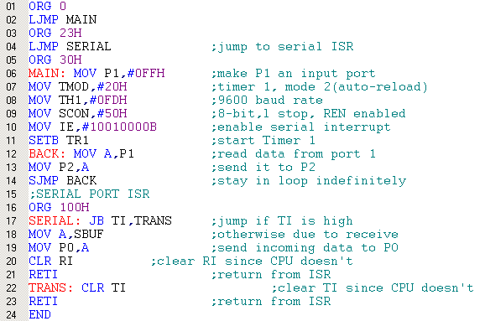
Example 11-9
Write a program in which the 8051 gets data from P1 and sends it to P2 continuously while incoming data from the serial port is sent to P0. Assume that XTAL = 11.0592 MHz. Set the baud rate at 9600.
vignan university

Slide 28
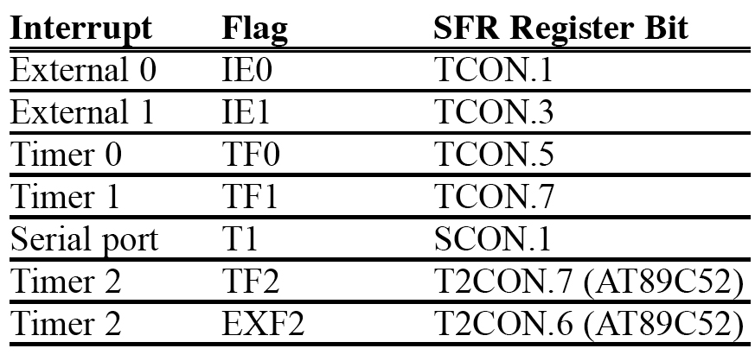
SECTION 11.4: PROGRAMMING THE SERIAL COMMUNICATION INTERRUPT
Table 11–2 Interrupt Flag Bits for the 8051/52
vignan university

Slide 29
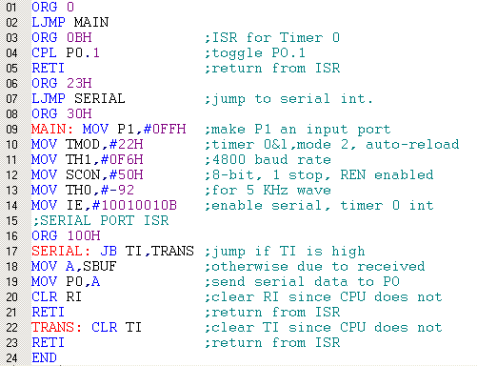
Example 11-10
Write a program using interrupts to do the following:
(a) Receive data serially and send it to P0,
(b) Have port P1 read and transmitted serially, and a copy given to P2,
(c) Make Timer 0 generate a square wave of 5 kHz frequency on P0.1.
Assume that XTAL = 11.0592 MHz. Set the baud rate at 4800.
vignan university

Slide 30
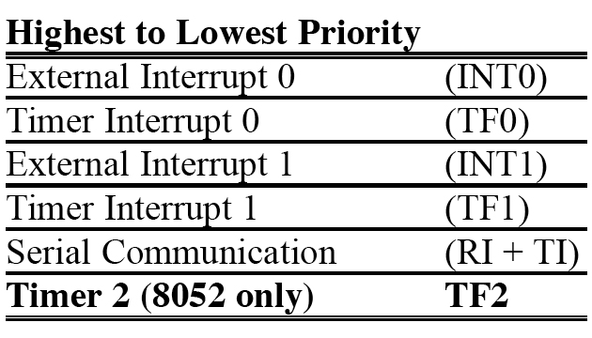
SECTION 11.5: INTERRUPT PRIORITY IN THE 8051/52
Interrupt priority upon reset
vignan university
Table 11–3 8051/52 Interrupt Priority Upon Reset

Slide 31
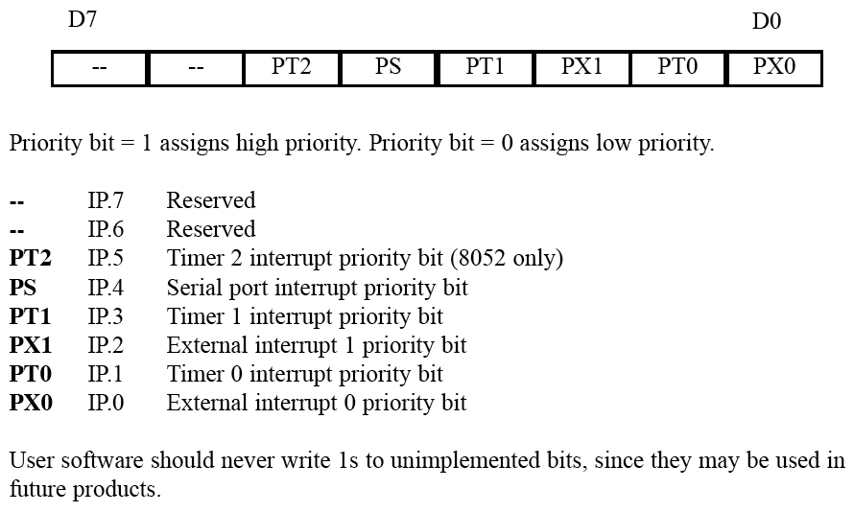
SECTION 11.5: INTERRUPT PRIORITY IN THE 8051/52
Setting interrupt priority with the IP register
Figure 11–8 Interrupt Priority Register (Bit-addressable)
vignan university

Slide 32
Example 11-12(a)
Program the IP register to assign the highest priority to INTI, then (b) discuss what happens if INT0, INT1, and TF0are activated at the same time. Assume that the interrupts are both edge-triggered.
(a) MOV IP,#00000100B or "SETB IP.2“
(b) when INT0, INT1, and TF0 interrupts are activated at the same time, the 8051 services INT1 first, then it services INT0, then TF0
vignan university

Slide 33
SECTION 11.5: INTERRUPT PRIORITY IN THE 8051/52
Interrupt inside an interrupt
  what happens if the 8051 is executing an ISR belonging to an interrupt and another interrupt is activated?
  a high-priority interrupt can interrupt a low-priority interrupt
  no low-priority interrupt can get the immediate attention of the CPU until it has finished servicing the high-priority interrupts
vignan university

Slide 34
SECTION 11.5: INTERRUPT PRIORITY IN THE 8051/52
Triggering the interrupt by software
  can test an ISR with instructions to set the interrupts high
  "SETB TF1" will interrupt the 8051 in whatever it is doing and force it to jump to the interrupt vector table
  don’t have to wait for Timer 1 to roll over
  useful for testing ISR
vignan university

Slide 35
Next …
Lecture Problems Textbook Chapter 11
  Answer as many questions as you can and submit via MeL before the end of the lecture.
Proteus Exercise 10
  Do as much of the Proteus exercise as you can and submit via MeL before the end of the lecture.
vignan university

